Slide 1
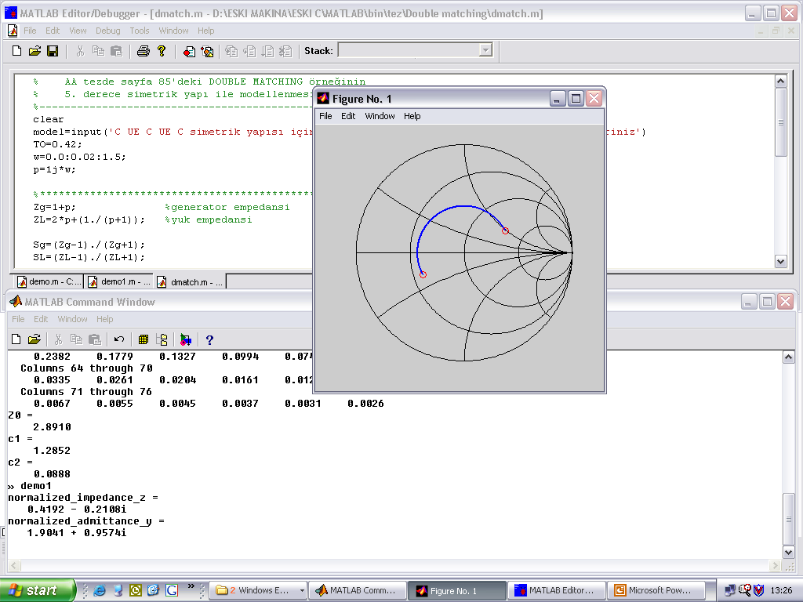
The Title of the BS Project
You can design your own logo for your project
Student(s) Name (s)
student@isik.edu.tr
Project Advisor:
Department of Electrical & Electronics Engineering
Işık University, Istanbul
Abstract
Heading of 2ndSection
The abstract should summarize the contents of the project and should contain at least 70 and at most 200 words. The text should be set in 24-point font size.
Th sections of the project can contain charts, equations and drawings. Include more visual materials than text !!
Introduction
All headings are 32- point size and should be in bold font.
Heading of 1st Section
Figure 2: Caption of Figure 2
The sections of the project can contain charts, equations and drawings. Include more visual materials than text !!
All definitions, equations and figures taken from other sources should be cited by defining the corresponding reference number, eg . [2]
References
[1]
[2]
[3]
(Eqn. 1)
You can add a link to your web site
Figure 1: Caption of Figure 1
POSTER DIMENSIONS: Width: 50 cm, Height: 70 cm

